Slide 1

Apex Institute of Technology
Department of Computer Science & Engineering
Data Mining and Warehousing
(CSF-334)
Dr Neha Agarwal
E11231
Assistant Professor
CSE(AIT), CU
DISCOVER . LEARN . EMPOWER

Slide 2
Contents to be Covered
What is concept description?
Data generalization and summarization-based characterization

Slide 3
What is Concept Description?
Descriptive vs. predictive data mining
Descriptive mining: describes concepts or task-relevant data sets in concise, summarative, informative, discriminative forms
Predictive mining: Based on data and analysis, constructs models for the database, and predicts the trend and properties of unknown data
Concept description:
Characterization: provides a concise and succinct summarization of the given collection of data
Comparison: provides descriptions comparing two or more collections of data

Slide 4
Concept Description vs. OLAP
Concept description:
can handle complex data types of the attributes and their aggregations
a more automated process
OLAP:
restricted to a small number of dimension and measure types
user-controlled process

Slide 5
Chapter 5: Concept Description: Characterization and Comparison
What is concept description?
Data generalization and summarization-based characterization
Analytical characterization: Analysis of attribute relevance
Mining class comparisons: Discriminating between different classes
Mining descriptive statistical measures in large databases
Discussion
Summary

Slide 6
Data Generalization and Summarization-based Characterization
Data generalization
A process which abstracts a large set of task-relevant data in a database from a low conceptual levels to higher ones.
Approaches:
Data cube approach(OLAP approach)
Attribute-oriented induction approach
1
2
3
4
Conceptual levels
5

Slide 7
Characterization: Data Cube Approach (without using AO-Induction)
Perform computations and store results in data cubes
Strength
An efficient implementation of data generalization
Computation of various kinds of measures
e.g., count( ), sum( ), average( ), max( )
Generalization and specialization can be performed on a data cube by roll-up and drill-down
Limitations
handle only dimensions of simple nonnumeric data and measures of simple aggregated numeric values.
Lack of intelligent analysis, can’t tell which dimensions should be used and what levels should the generalization reach

Slide 8
Attribute-Oriented Induction
Proposed in 1989 (KDD ‘89 workshop)
Not confined to categorical data nor particular measures.
How it is done?
Collect the task-relevant data( initial relation) using a relational database query
Perform generalization by attribute removal or attribute generalization.
Apply aggregation by merging identical, generalized tuples and accumulating their respective counts.
Interactive presentation with users.

Slide 9
Basic Principles of Attribute-Oriented Induction
Data focusing: task-relevant data, including dimensions, and the result is the initial relation.
Attribute-removal: remove attribute A if there is a large set of distinct values for A but (1) there is no generalization operator on A, or (2) A’s higher level concepts are expressed in terms of other attributes.
Attribute-generalization: If there is a large set of distinct values for A, and there exists a set of generalization operators on A, then select an operator and generalize A.
Attribute-threshold control: typical 2-8, specified/default.
Generalized relation threshold control: control the final relation/rule size. see example

Slide 10
Basic Algorithm for Attribute-Oriented Induction
InitialRel: Query processing of task-relevant data, deriving the initial relation.
PreGen: Based on the analysis of the number of distinct values in each attribute, determine generalization plan for each attribute: removal? or how high to generalize?
PrimeGen: Based on the PreGen plan, perform generalization to the right level to derive a “prime generalized relation”, accumulating the counts.
Presentation: User interaction: (1) adjust levels by drilling, (2) pivoting, (3) mapping into rules, cross tabs, visualization presentations.
See Implementation See example See complexity

Slide 11
Example
DMQL: Describe general characteristics of graduate students in the Big-University database
use Big_University_DB
mine characteristics as “Science_Students”
in relevance to name, gender, major, birth_place, birth_date, residence, phone#, gpa
from student
where status in “graduate”
Corresponding SQL statement:
Select name, gender, major, birth_place, birth_date, residence, phone#, gpa
from student
where status in {“Msc”, “MBA”, “PhD” }

Slide 12
Class Characterization: An Example
Initial Relation
Prime Generalized Relation
See Principles
See Algorithm
See Implementation
See Analytical Characterization

Slide 13
Presentation of Generalized Results
Generalized relation:
Relations where some or all attributes are generalized, with counts or other aggregation values accumulated.
Cross tabulation:
Mapping results into cross tabulation form (similar to contingency tables).
Visualization techniques:
Pie charts, bar charts, curves, cubes, and other visual forms.
Quantitative characteristic rules:
Mapping generalized result into characteristic rules with quantitative information associated with it, e.g.,

Slide 14
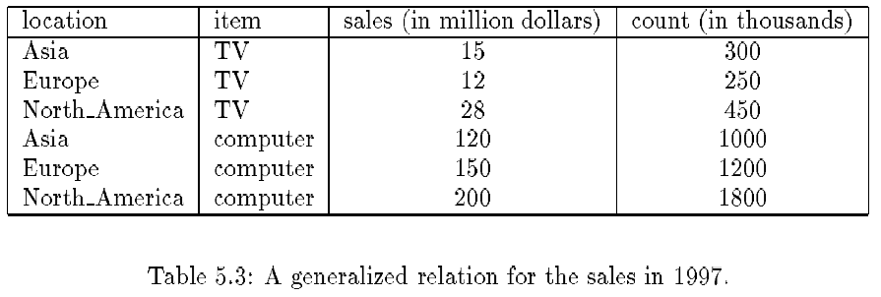
Presentation—Generalized Relation

Slide 15
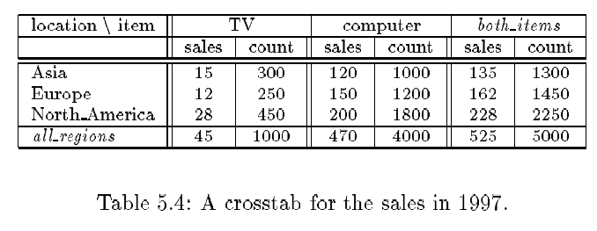
Presentation—Crosstab

Slide 16
Implementation by Cube Technology
Construct a data cube on-the-fly for the given data mining query
Facilitate efficient drill-down analysis
May increase the response time
A balanced solution: precomputation of “subprime” relation
Use a predefined & precomputed data cube
Construct a data cube beforehand
Facilitate not only the attribute-oriented induction, but also attribute relevance analysis, dicing, slicing, roll-up and drill-down
Cost of cube computation and the nontrivial storage overhead

Slide 17
Homework
Discuss the concept of concept description.
Discuss Data Generalization and Summarization-based Characterization.

Slide 18
References
TEXT BOOKS
Introduction to Data Mining, Tan, Steinbach and Vipin Kumar, Pearson Education, 2016
REFERENCE BOOKS
Data Mining: Concepts and Techniques, Pei, Han and Kamber, Elsevier (2nd edition)
Journals
https://www.sciencedirect.com/topics/computer-science/data-generalization

Slide 19
Thank you
Please Send Your Queries on:
e-Mail: neha.e11231@cumail.in

